Slide 1
Coding & Reimbursement
Special Notes:
Rates listed are estimates: all reimbursement rates vary by practice locality, historic practice/NPI performance, sequestration, and practitioner license.
Coding, per the AMA, and supported by the courts, is the responsibility of the practitioner. MyCareWare makes recommendations only.

Slide 2
What Must Be Completed?
Category | Details
Vitals | Blood Pressure, Height, Weight, BMI
Personal and Family Medical History | Medical events of the beneficiary’s parents, siblings, and children, including conditions that may be hereditary or place the beneficiary at increased risk; Past medical and surgical history, including experiences with illnesses, hospital stays, operations, allergies, injuries, and treatments; Use of, or exposure to, medications and supplements, including calcium and vitamins; Providers should pay close attention to opioid use.
Current Providers and Suppliers | Include current beneficiary providers and suppliers that regularly provide medical care
Health Assessments | Self assessment of health risks; ADLs, including dressing, bathing and walking; IADLs, including shopping, housekeeping, managing own medications, and handling finances; Mental health conditions including depression, substance use disorder, and cognitive impairment; Other conditions: hearing impairment, home safety, fall/mobility risk.
Written Plan (Personalized Prevention Plan) | Written plan provided to patient, that includes: Recommendations for screenings and immunizations The beneficiary’s HRA, health status and screening history, and age-appropriate preventive services Medicare covers Personalized health advice and appropriate referrals to health education or preventive counseling services or programs
What Else We Like | NOT REQUIRED: Elder mistreatment; Bladder control; Vision acuity with eyewear.
Advanced Directives | Advanced care planning when delivered with AWV. Minimum 16 minutes.

Slide 3
How to Pass an Audit
Medicare Can Update the Requirements As Often As Quarterly
Must Update Changes to AWV
Must Update Changes to Medicare Beneficiary Preventive Screenings and Services as part of the Written Patient Personalized Prevention Plan
Prove compliance:
By Patient
Copy of Patient Personalized Prevention Plan
Copy of the ”Test” at the Time of Service
Patient’s Answers for the ”Test”
Time Spent
AWV
Advanced Directives
Care Coordination:
Copy of patient results to PCP if delivered by someone other than the PCP

Slide 4
Codes to Register in Your EHR
G0402: IPPE (AKA Welcome to Medicare)
G0403: EKG for IPPE
G0404: EKG tracing for IPPE
G0405: EKG interpret and report for IPPE
G0438: First AWV
G0439: Subsequent AWV
G0513: Prolonged Preventive Services, 1st 30
G0514: Prolonged Preventive Services, 2nd 30
99497 - 33: Advanced Directives, 1st 16 with modifier 33 indicating delivered in concert with AWV (results in no copay for patient)
99498 - 33: Advanced Directives, additional time, with modifier 33 indicating delivered in concert with AWV (results in no copay for patient)
G0506: Chronic Care Management Planning (for Practices considering CCM program)

Slide 5
CMS Fee Look Up Tool Averages by Code
Codes and National Average Reimbursements for Physicians
 | Welcome to Medicare G0402 | First AWV G0438 | Subsequent AWV G0439 | For FQHCs Always G0468
National Average Reimbursement | $169 | $174 | $118 | $70
Advanced Care Planning – No Copay (99497) | MAC Contingent | $86 | $86 | Not Recommended
Optional EKG (G0403/404/405) | Yes, Has Copay ($8-$17) | No | No | Not Recommended
Prolonged Preventive Service Applies (G0513/514) | Yes ($62) | Yes ($62) | Yes ($62) | No
Total Average Reimbursement | $239 | $322 | $266 | $70

Slide 6
Coding Decision-Making: Which Test
Per Medicare Beneficiary | Welcome to Medicare G0402 | First AWV G0438 | Subsequent AWV G0439
Expected Timing | 0-12 Months | 13-24 Months | > 24 Months
How Many Times The Code can be Billed | Once | Once | Unlimited
Limits | Use Or Lose Use it in months 0-12 or lose it | Once in a lifetime After month 12, use it once anytime in the lifetime | Annually after 24th month
Prolonged Preventive Service Applies (G0513/514) | Applies when the initial visit is more than 15 minutes over the time recommended by Medicare
Total Average Reimbursement | $239 | $322 | $266

Slide 7
Advanced Care Planning
Other Recommended Tests In Conjunction with AWV
Advanced Care Planning: 99497
No Copay, IF Delivered SAME DAY as Welcome or AWV
Use MODIFIER -33
On the same claim as AWV
Requires 16 Minutes Time Spent
Can be billed a second time in the year (patient does have copay)
Our Goal in First Year: Baseline Education
What are Advanced Directives and Why are They Important?

Slide 8
IPPE: Welcome to Medicare (G0402)
Other Codes: In Conjunction with Welcome G0402 ONLY
Welcome to Medicare OPTIONAL EKG
G0403
$17
G0404
$8
G0405
$8
Electrocardiogram, routine EKG with 12 leads; performed as a screening for the initial preventive physical examination with interpretation and report
Electrocardiogram, routine EKG with 12 leads; tracing only, without interpretation and report, performed as a screening for the initial preventive physical examination
Electrocardiogram, routine EKG with 12 leads; interpretation and report only, performed as a screening for the initial preventive physical examination
Recommend Administer BEFORE Welcome Begins, Capture Type in Software For Record-Keeping, and will drop to Coding Report

Slide 9
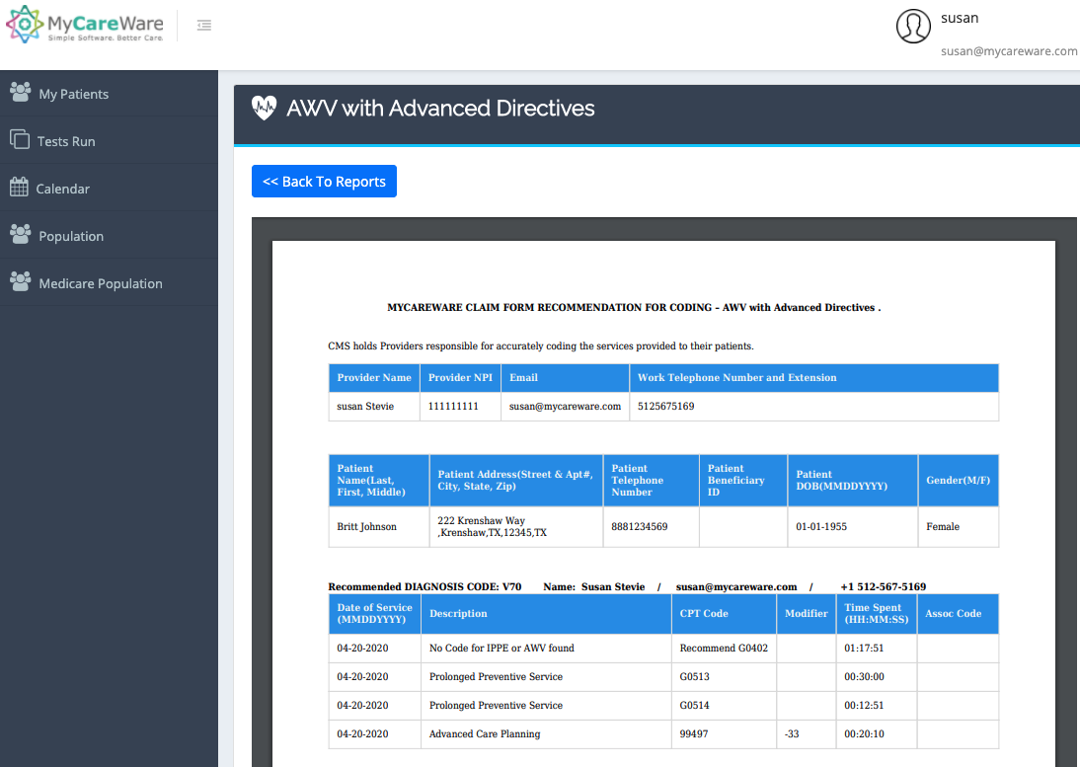
Claim Form Per Visit
Use Diagnosis Code V.70
Produce a claim form “Superbill” per Visit for use by coding team
Available on the website or can be emailed to billing inbox

Slide 10
Issues
Issue | Comment
Medicare Administrative Contractors (MACs) advise incorrect modifier for 99497 | We provide documentation (see appendix).
E.H.R.s haven’t added codes for Preventive Services (particularly smaller, less widely used E.H.R.s) | We provide codes so you can register (see prior page and appendix).
Medicare Advantage programs reimburse at lower rates than Medicare | We encourage you to talk with your payor. Most MA programs WANT preventive services done. They may: (1) increase reimbursement to match Part B; (2) give your practice incentives to get the services in current year; (3) provide you with a list of patients they’ve targeted so that you prioritize getting the preventive services completed.
Physical Exam | Not covered by Medicare so patient pays 100% out of pocket. MAY be covered by Medicare Advantage programs – ask first.
Some MACs approve ACP with IPPE | Check with your MAC before adding ACP codes to IPPE. If not covered, patient copay required.
Some Medicare Advantage plans are challenging use of the PPPS codes. | We provide documentation (see appendix).

Slide 11
Appendix

Slide 12
Coding Documentation: AWV & Advanced Care Planning, Code: 99497
Page 10/11 of 16 ICN 905706 August 2018
MLN Booklet
https://www.cms.gov/Outreach-and-Education/Medicare-Learning-Network-MLN/MLNProducts/downloads/AWV_chart_ICN905706.pdf

Slide 13
Coding Documentation: Billing Codes, G0513 and G0514
Per CMS, Prolonged Preventive Service Codes G0513 and G0514 apply to Annual Wellness Visit codes G0438 and G0439.
Medicare Advantage payers are required by law to follow CMS rules. They may add services, but cannot deny services specified by CMS.

Slide 14
After Visit Coding (Follow Ups)
Additional Prentive Services
Alcohol Misuse Screening and Counseling---(G0442/G0443)
Bone Mass Measurements---(See Codes Online)
Cardiovascular Disease Screening Test---(80061+82465/83718/84478)
Colorectal Cancer Screening---(See Codes Online)
Counseling to Prevent Tobacco Use---(99406/99407)
Depression Screening---(G0444)
Diabetes Screening---(82947,82950,82951)
Diabetes Self-Management Training---(G0108/G0109)
Glaucoma Screening---(G0117/G0118)
Hepatitis C Virus (HCV) Screening---(G0472)
Human Immunodeficiency Virus (HIV) Screening---(80081,G0432/433/435/475)
Influenza, Pneumococcal, and Hepatitis B Vaccinations and their Administration---(G0008, See Codes Online)
Intensive Behavioral Therapy (IBT) for Cardiovascular Disease (CVD), also known as a CVD risk reduction visit---(G0446)
IBT for Obesity---(G0447/G0473)
Medical Nutrition Therapy---(97802/03/03, G0271/272)
Prostate Cancer Screening---(GO102/103)
Screening for Cervical Cancer with Human Papillomavirus (HPV) Tests---(90739/40/43/44/46/47, G0010)
Screening for Lung Cancer with Low Dose Computed Tomography---(G0296/G0297)
Screening for Hepatitis B Virus (HBV) Infection---(G0499)
Screening for Sexually Transmitted Infections (STIs)---(See Codes Online)
High Intensity Behavioral Counseling (HIBC) to Prevent STIs---(G0445)
Screening Mammography---(77063/77067)
Screening Pap Tests---(See Codes Online)
Screening Pelvic Examination (includes a clinical breast examination)---(G0101)
Ultrasound Screening for Abdominal Aortic Aneurysm (AAA)---(76706)

